Slide 1
Controlling Permissions to Azure SQL Database and Azure SQL Managed Instance using Excel and Azure DevOps

Slide 2
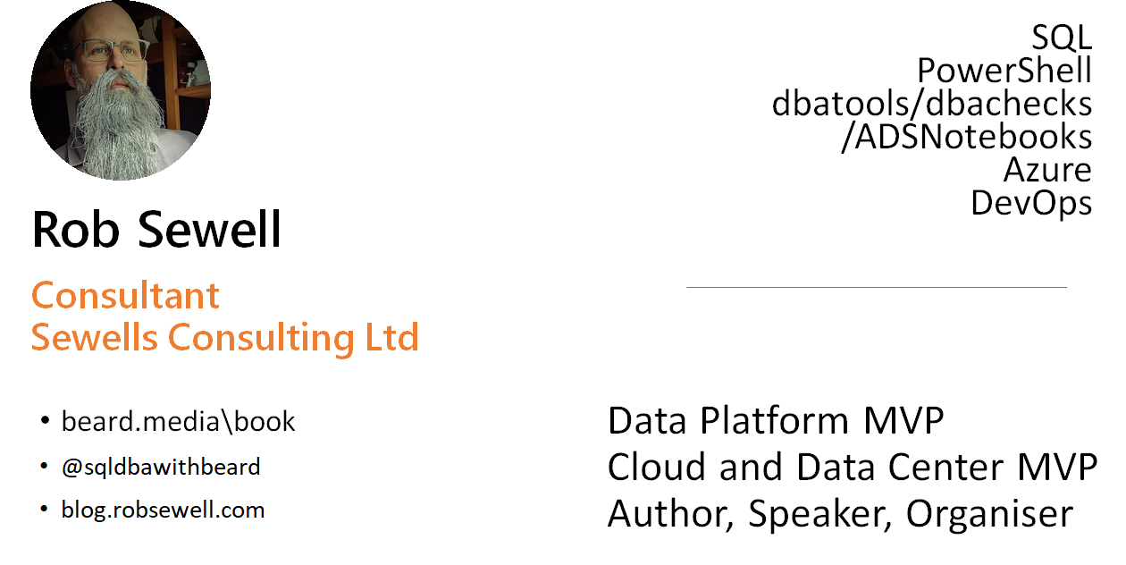

Slide 3
Problem Statement
Automate a solution to make it easy for the Operational Team to control permissions to the Azure SQL Database and Azure SQL Managed Instance estate

Slide 4
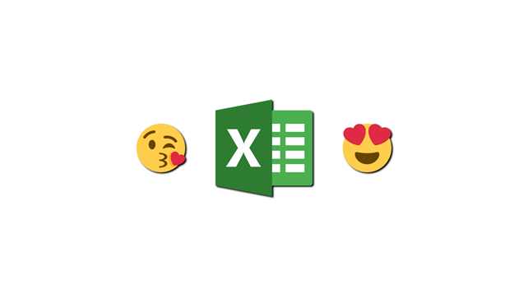
Requestor
“We like to use Excel”

Slide 5
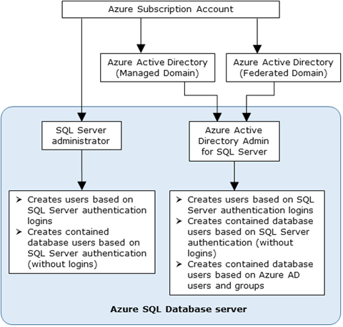
Creating Azure SQL Database Users

Slide 6


Creating Azure SQL Database Users

Slide 7
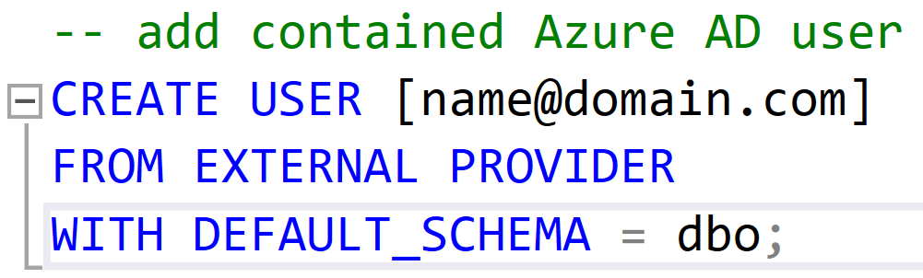
Creating an AAD Contained Database User
Only connections established with Active Directory accounts can create other Active Directory users

Slide 8
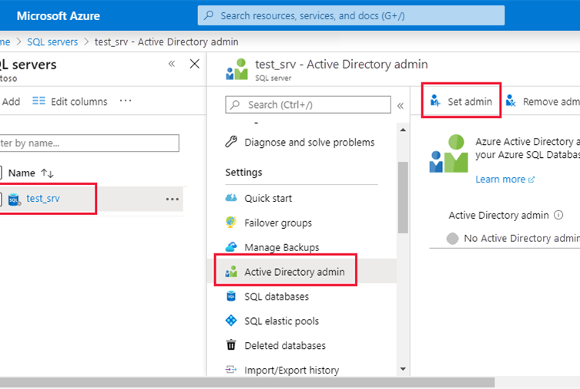
Need to set the Active Directory Admin

Slide 9
Problem
•Cant Set Active Directory Admin to a SPN
•Add the SPN to a Group and Add the Group
Solution

Slide 10
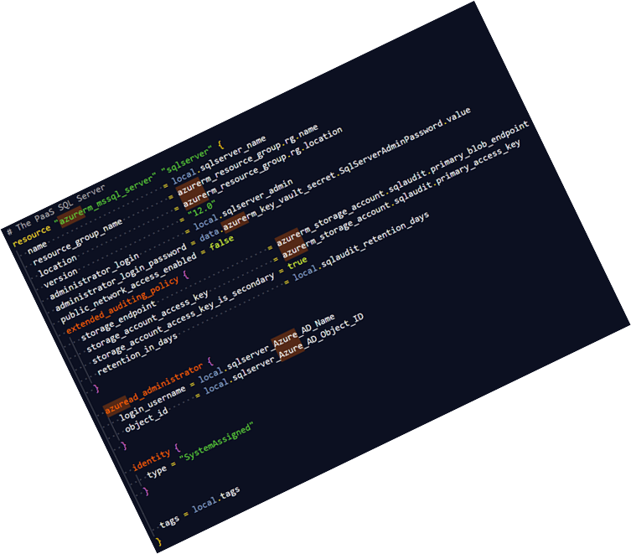
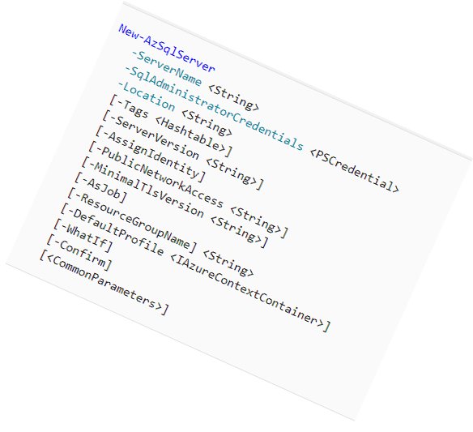
Problem
•Cant Set Active Directory Admin to a SPN
•Add the SPN to a Group and Add the Group
Solution

Slide 11
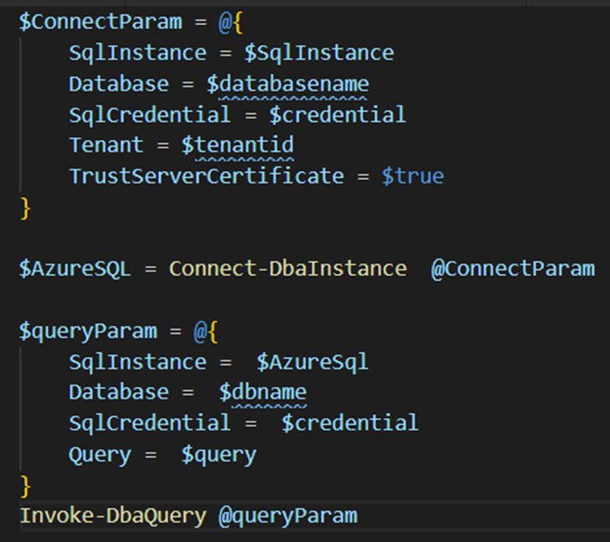
Problem
•Need to login as the SPN to run the T-SQL
•Use dbatools https://dbatools.io
Solution

Slide 12
Creating an AAD Contained Database User
Only connections established with Active Directory accounts can create other Active Directory users

Slide 13
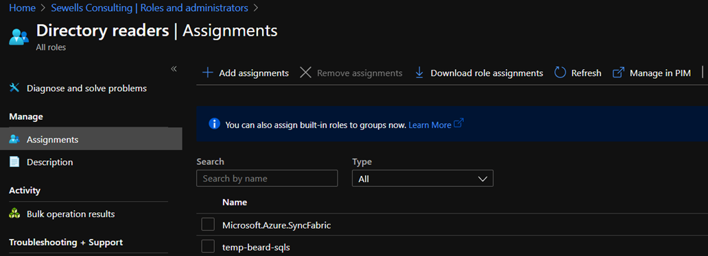
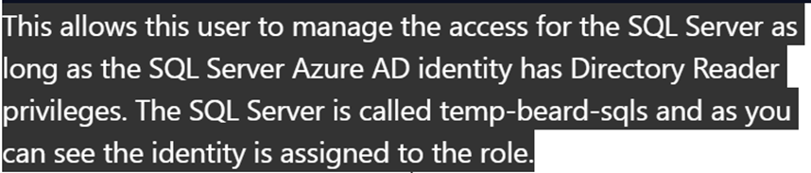

Slide 14
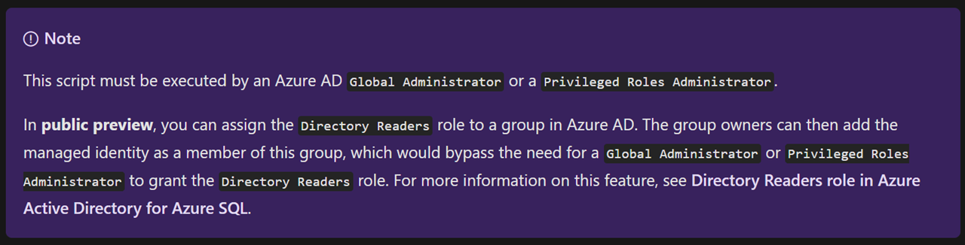
The privileges required to do this for a single identity are quite high

Slide 15
So now we have all that we need
•An Excel File for Permissions
•Azure SQL instance with AAD Identity and SPN with Directory Reader
•dbatools to run the query
•Azure Key Vault for storing secrets
•Azure DevOps for running the code

Slide 16
Pics of deployment task pics of excel etc

Slide 17
I wrote about this here
https://blog.robsewell.com/blog/dbatools/azure%20devops/sql%20server/creating-azure-ad-users-with-a-spn-with-powershell-using-secrets-management-azure-key-vault-spns-azure-sql-database-and-dbatools/

